Slide 1
Gattaca and The Great Gatsby: Comparative Essay
Learning Intention: Students will understand what they need to know to pass the assessment.

Slide 2
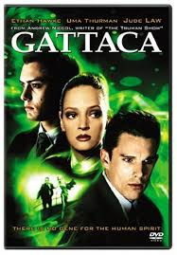

Texts from different genres, that look at similar ideas or issues. Remember that an idea is never just one word. Remember that an issue is something that can be debated.

Slide 3
The important strand of the marking criteria
Demonstrates facility with metalanguage of text types (conventions), text structures, language features, ideas, issues and representation. Conventions in feature film include:
Symbolic: setting, objects, colour, character’s clothing, facial expression and appearance.
Technical: camera angles (low, high), shot length (extreme close up, close up, medium shot, long shot), leading lines (or vector lines) these are lines within the composition that lead the viewer to focus on a particular aspect of the shot
Audio: sound effects, soundtrack, voice over, dialogue (only use this in conjunction with the other conventions.)
Written: writing on signs, cards etc
You also need to be able to discuss composition or mise en scene. Where people and objects are place within a scene (foreground, background etc.) and why this is significant.
You need to do the same for The White Tiger using language features and novel conventions. For some this proved a challenge in last assessment.

Slide 4
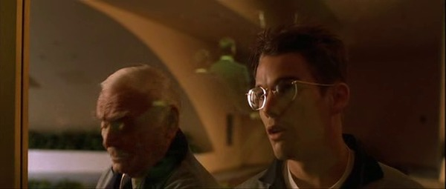

Slide 5
One example that the setting represents obstacles for the protagonist, Vincent, is the director's use of mise-en-scene. Earlier in the film, while Vincent is working as a janitor there is a long shot with a pane of glass in the foreground and a reflected image of Vincent looking through the glass with a determined expression on his face. The reflection in the glass allows the audience to realise that they observing Vincent watch the chosen citizens ascend the escalator into the Gattaca Complex. The escalator and the golden lights along the sides that create leading lines upwards symbolise the exclusive status of the genetically superior citizens as long they are allowed to literally (and symbolically) move up in the world. This establishes both the protagonists’s awareness of the obstacle and his determination to reach his dream and this is further reinforced by his dialogue to his supervisor, when Vincent states that he intends to be on the "other side”of the glass.

Slide 6
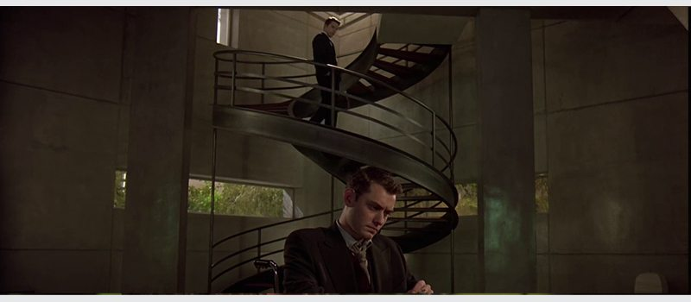
Have a go at your own analysis of the image below. Identify the conventions and the idea represented.

Slide 7
There is a lot of information on Gattaca online. Use it to support your understanding, but not in place of your own understanding.

Slide 8
www.gradesaver.com › gattaca › study-guide › summary
Spiral staircase
The staircase in Vincent and Jerome's apartment is spiral-shaped, representing the shape of the double-helix model of DNA. This is a focal point of many scenes, as it symbolizes the society founded upon genetics and scientific ideals. It is also a powerful symbol for life and humanity, key themes explored in the film.
As well as this, the spiral staircase in the mise-en-scene of Jerome's apartment symbolically represents the parallel between Vincent and Jerome. This is most clearly seen towards the end of the film, when Vincent stands at the top of the stairs and Jerome is placed at the bottom. This illustrates that the two have essentially 'become' each other - while Vincent adopted Jerome's identity, Jerome fell further into disrepute. The image of the spiral staircase is so central to the film that it was used in promotional posters and is now on the DVD cover.
The staircase also represents human drive and determination. This can be seen when Jerome has to climb the staircase. He has to pull himself up slowly, which is incredibly difficult as he is paralysed from the waist down, nonetheless he manages to do so. This is the first moment in the film where Jerome strives to achieve something, as he is typically characterized as jaded and cynical.

